Slide 1
Physical Geology & Land Use
Forces that shape the surface of the Earth and how humans use the land for a variety of purposes.

Slide 2
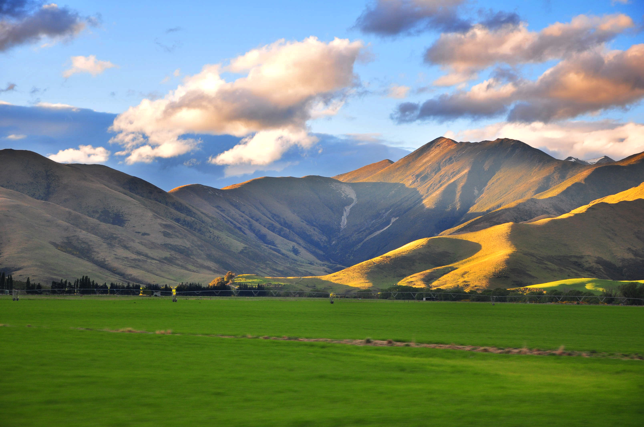
Driving Questions:
What makes up the Earth’s surface?
How does it change?
How has the surface of the Earth changed over time?
How have humans influenced the surface of the Earth?

Slide 3
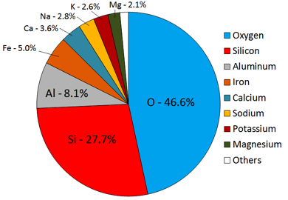
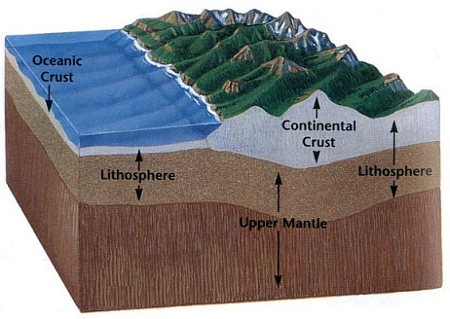
Earth’s Surface
The constantly changing surface features we see are all on the Earth’s crust.
The crust is 95% igneous and metamorphic rock (mostly igneous) and 5% sedimentary rock.

Slide 4
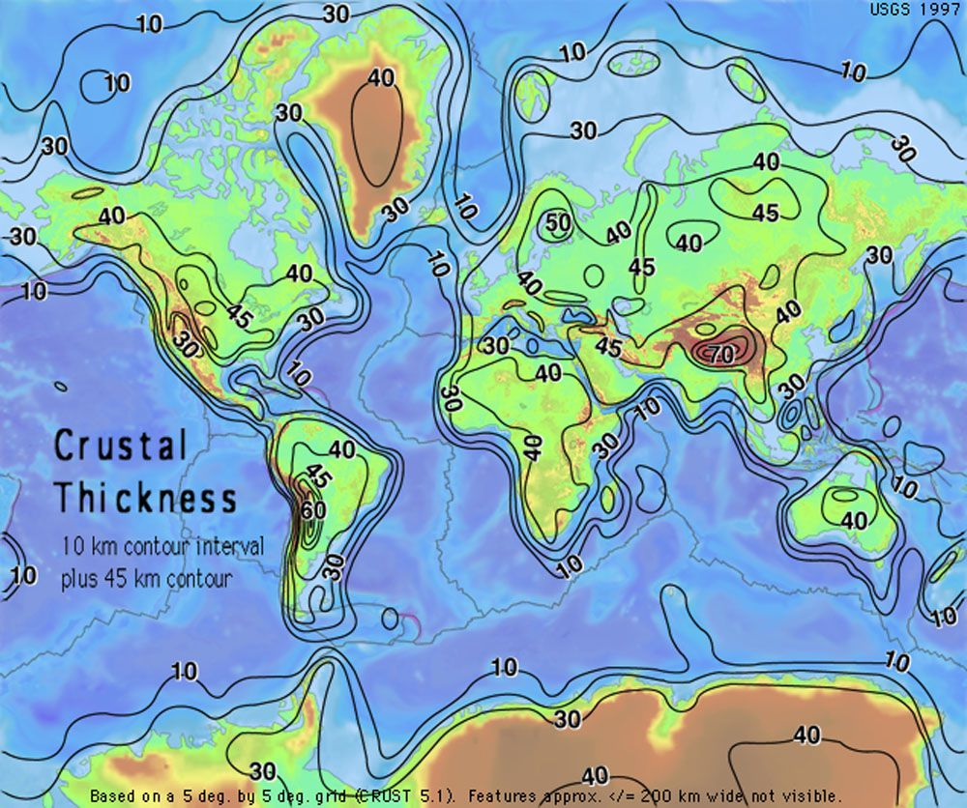
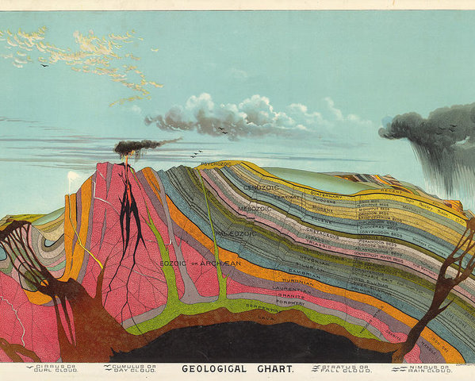
Earth’s Surface The surface of the Earth is not the same everywhere and is constantly changing over time.

Slide 5
Basic Processes Impacting the Lithosphere
Weathering: breaking rocks down into smaller pieces called sediments
Erosion: carries sediments to a new location
Deposition: drops sediments in areas to form sediment layers
Factors that influence deposition: velocity of moving currents, elevation

Slide 6
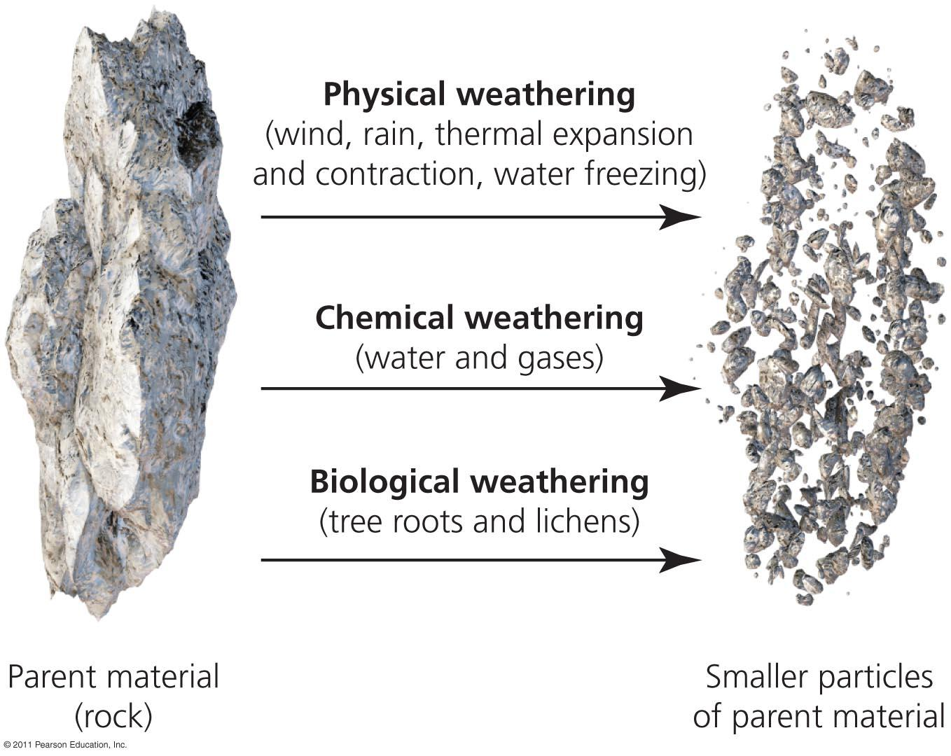

Slide 7
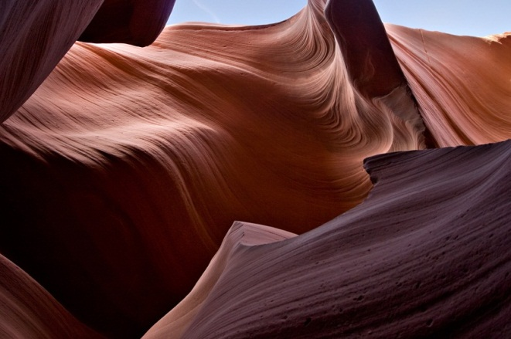
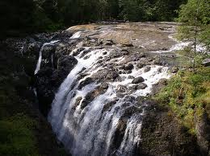
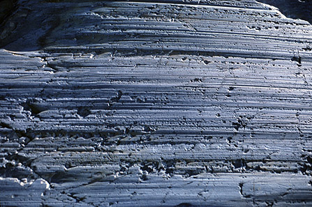
Weathering
Mechanical weathering: physical forces that break rocks down into smaller sediments
Types of Mechanical Weathering
Abrasion: the physical force of smaller sediments grinding down larger sediments in a moving current or under pressure

Slide 8
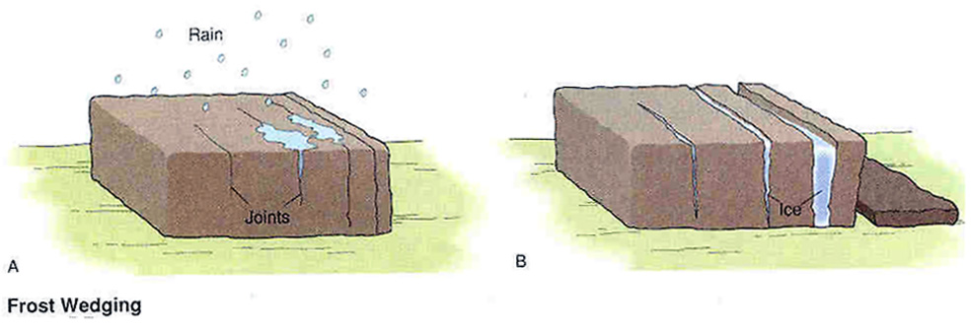
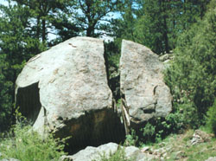
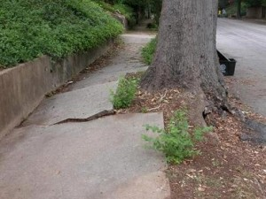
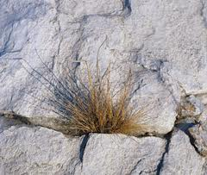
Weathering
b) Ice wedging: water seeps into cracks in rocks then freezes, the ice expands and breaks down the rocks
c) Organic activity – natural activity of living organisms causes rocks to break apart .

Slide 9
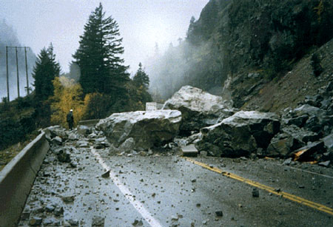
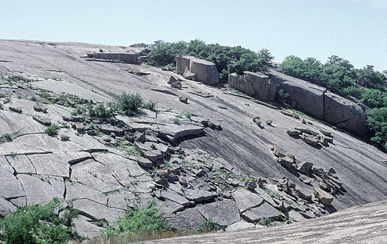
Weathering
d) Mass movement: transfer of rock and soil down a slope due to gravity
- this causes collisions of rocks with one
another, a process that breaks big rocks
into smaller rocks
e) Exfoliation: when pressure is released from rocks underground, the exposed surface of the rock can peel off in layers

Slide 10
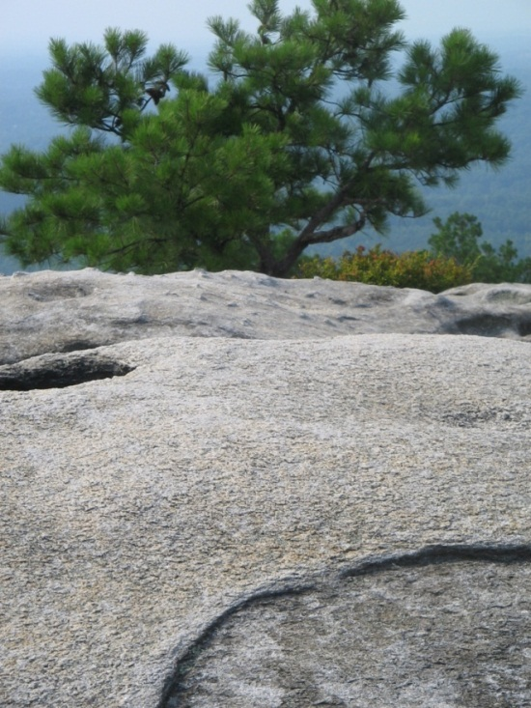
Weathering
Chemical Weathering: process in which rocks are decomposed, dissolved, or loosened by chemical methods
Types of Chemical Weathering
Water: minerals or gases react with water causing the decomposition of rock particles
(Example: Acid Rain)

Slide 11
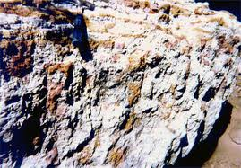
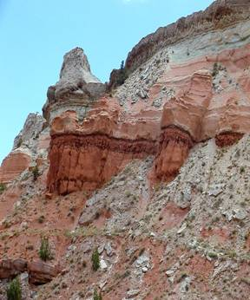
Weathering
b) Carbonation: when CO₂ from the air dissolves in water to produce carbonic acid (same acid in soft drinks!)
dissolves soft rocks like limestone
c) Oxidation: rusting of metallic minerals through a reaction with water and oxygen
- example: RUST!

Slide 12
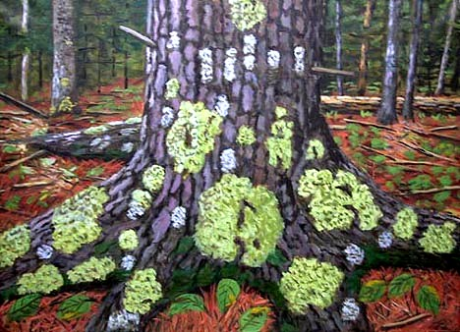
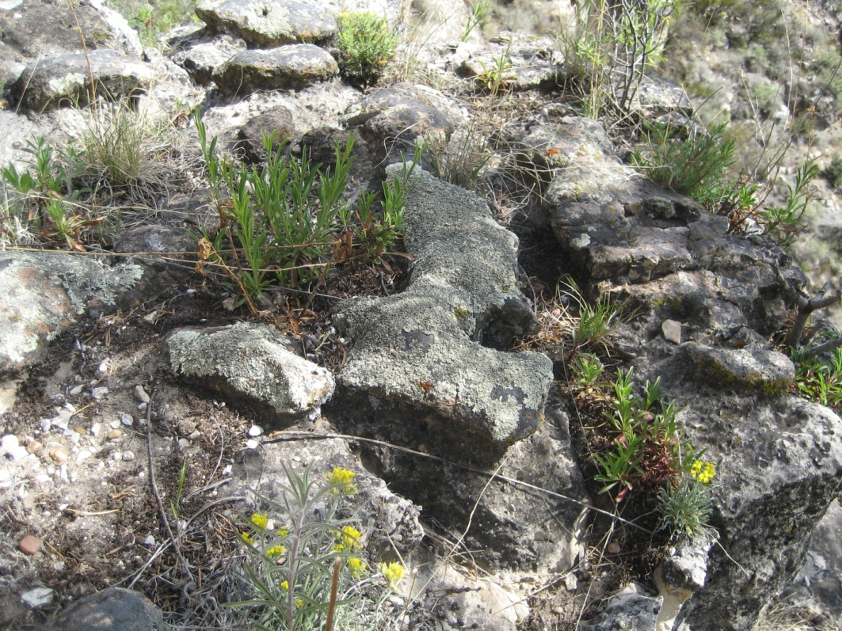
Weathering
d) Plant acids – acids secreted (pushed out) from plants can actually dissolve a rock into soil
-example: lichen

Slide 13
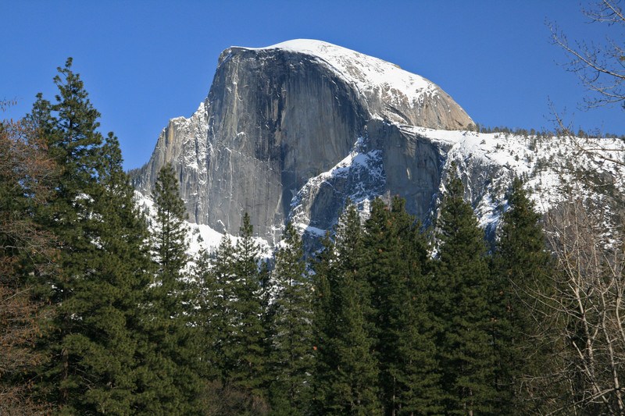
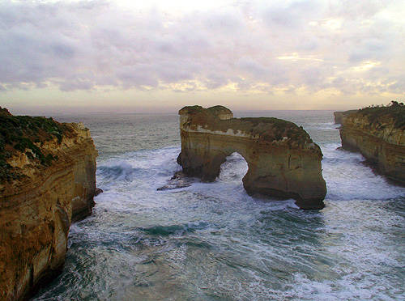
Rates of Weathering
Environmental factors can affect the rate at which weathering occurs.
The 3 main factors that affect rates of weathering are surface area, rock characteristics, and climate.

Slide 14
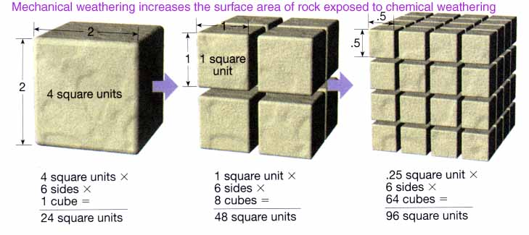
Rates of Weathering
Surface Area: more exposed surface area increases the rates of weathering because more of the surface is affected by the weathering processes

Slide 15
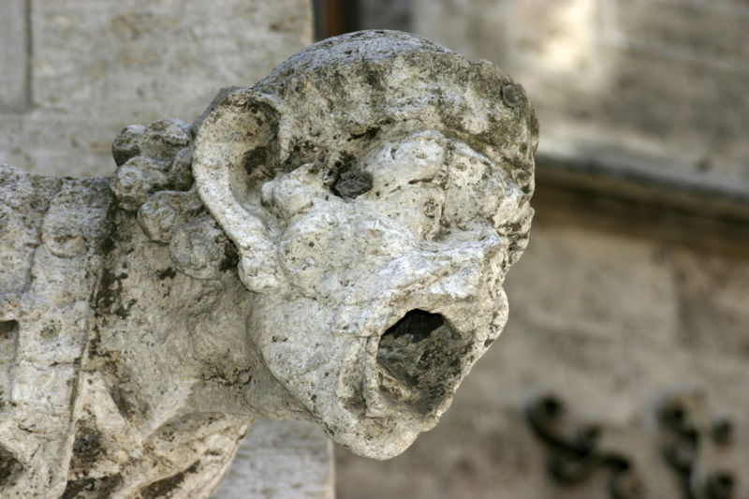
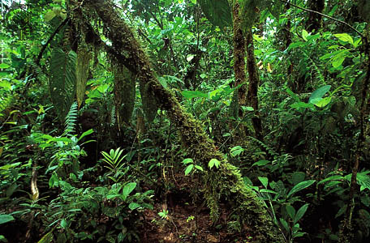
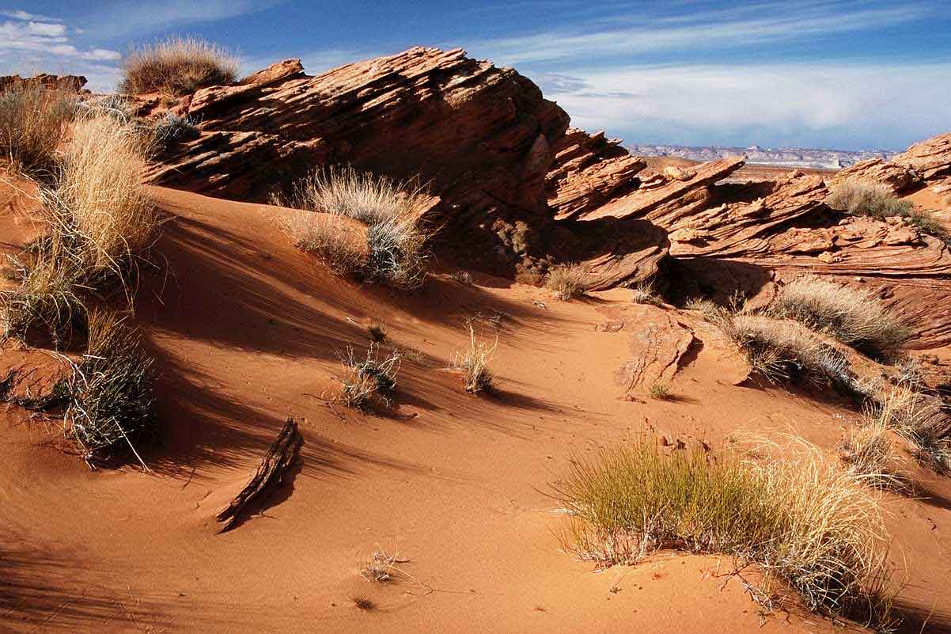
Rates of Weathering
Rock Characteristics: cracks in rocks or soft composition of a rock will accelerate the rate of weathering
(Example: Marble degrades faster than Granite)
Climate: temperature and moisture control freezing cycles and how many plants will grow in an area

Slide 16
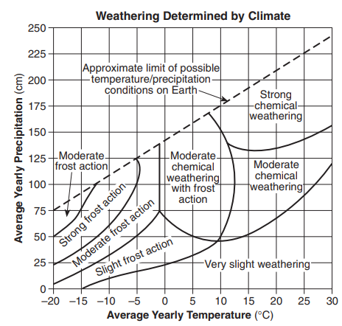

Slide 17
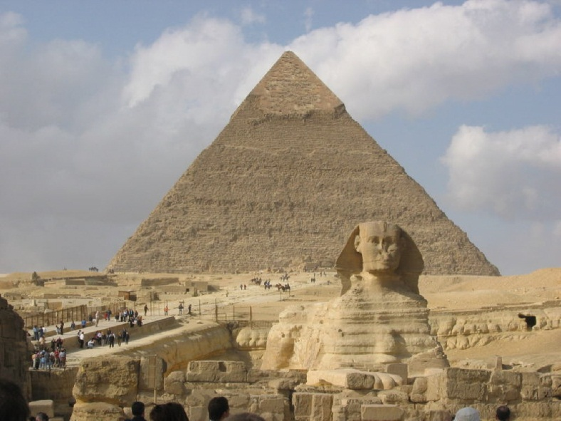
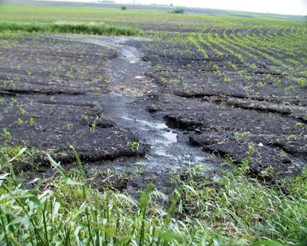
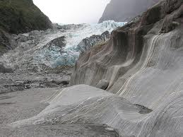
Erosion
The main purpose of erosion is to transport sediments that have been broken down by weathering and deposit them in a new location.
Erosion forces include wind, water, ice, and living organisms.

Slide 18
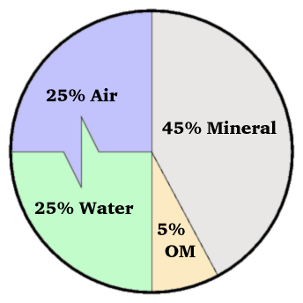
Deposition of sediments leads to the creation of soil.
Soil: a part of the Earth’s crust that supports plant growth
Composition of Soil
50% Water and Air
45% Minerals
5% Organic matter (decomposing plants and animals also called humus)

Slide 19
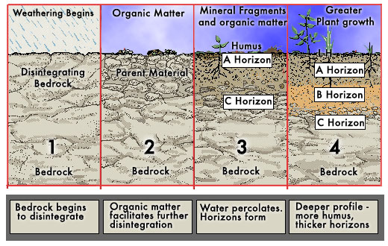
Soil Formation
Soil forms because of the accumulation of sediments in an area.
Parent rock: the main source of mineral matter for a soil (also called bedrock)

Slide 20
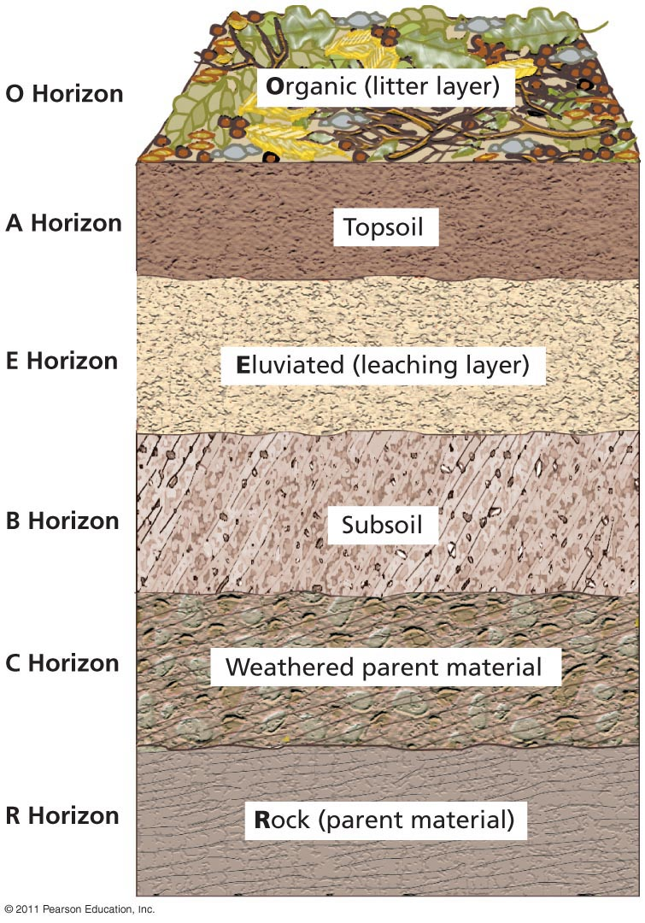
Soil Comparisons
Soil profile: vertical section through all of the soil horizons
Soil horizon: variations in soil composition, texture, structure, and color at different depths

Slide 21
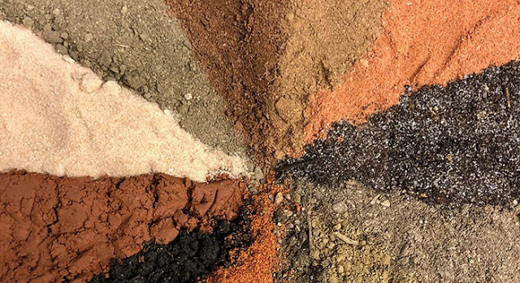
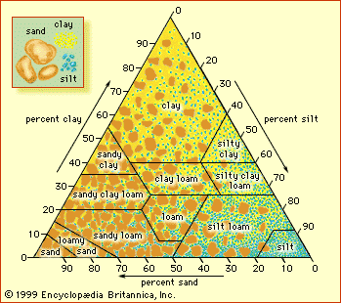
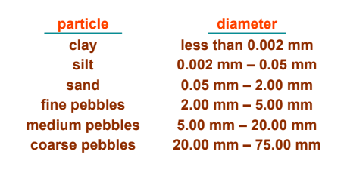
Soil Identification
Soil texture: directly related to the particle sizes and affects how air and water move through the soil layers
size categories- clay, silt, sand

Slide 22
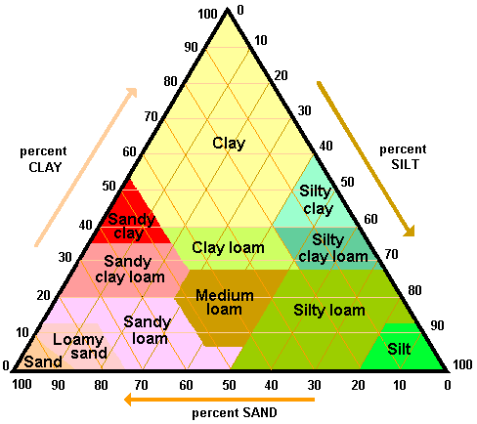
Soil Identification
To use the diagram:
Look at the percentages of clay, silt and sand in a soil sample and find where the 3 percentages meet.
Example:
30% Clay, 10% Silt, 60% Sand = _____________

Slide 23
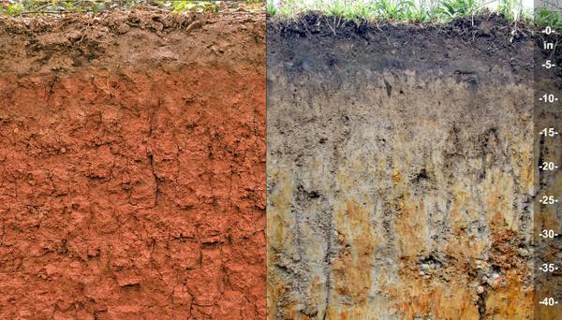
Soil Identification
Soil color = indicates its composition and fertility
Black or dark brown = rich in organic matter
Pale gray or white = indicates leaching

Slide 24
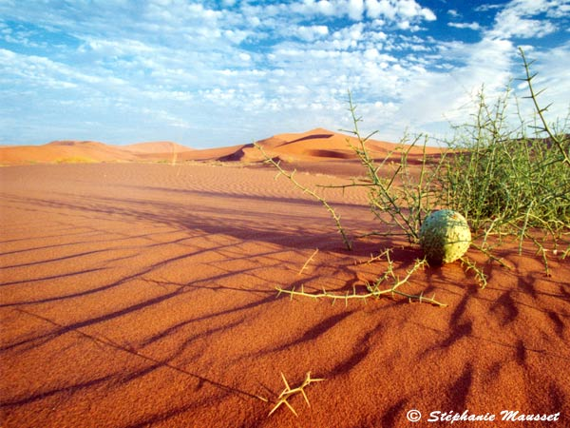
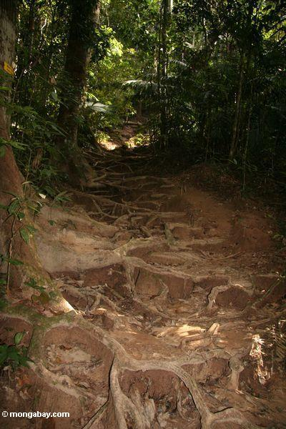
Key factors to soil formation
Climate: soils form faster in warm, wet climates (controlled by temperature and precipitation)
Organisms: plants and decomposers add organic matter
Topography: areas with steeper slopes are less likely to accumulate sediments for soil formation
Parent material: influences properties of resulting soil
Time: soil can take decades to millennia to form

Slide 25
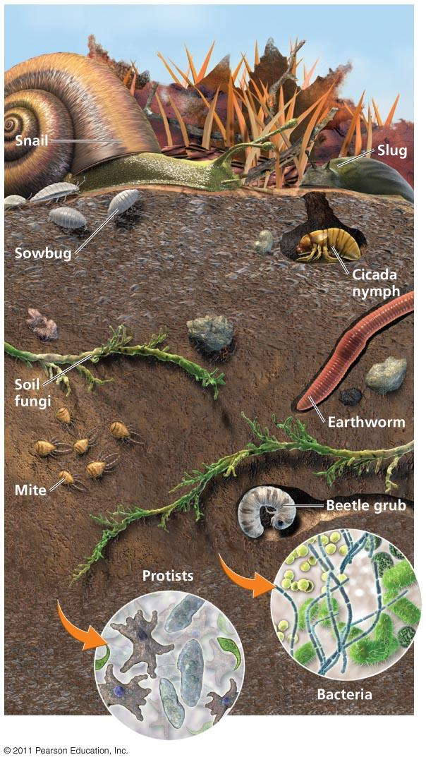
Soil as a system
Since soil is composed of interacting living and nonliving matter, it is considered an ecosystem
Dead and living microorganisms
Decaying material
Bacteria, algae
Habitat for earthworms, insects, mammals, reptiles, and amphibians

Slide 26
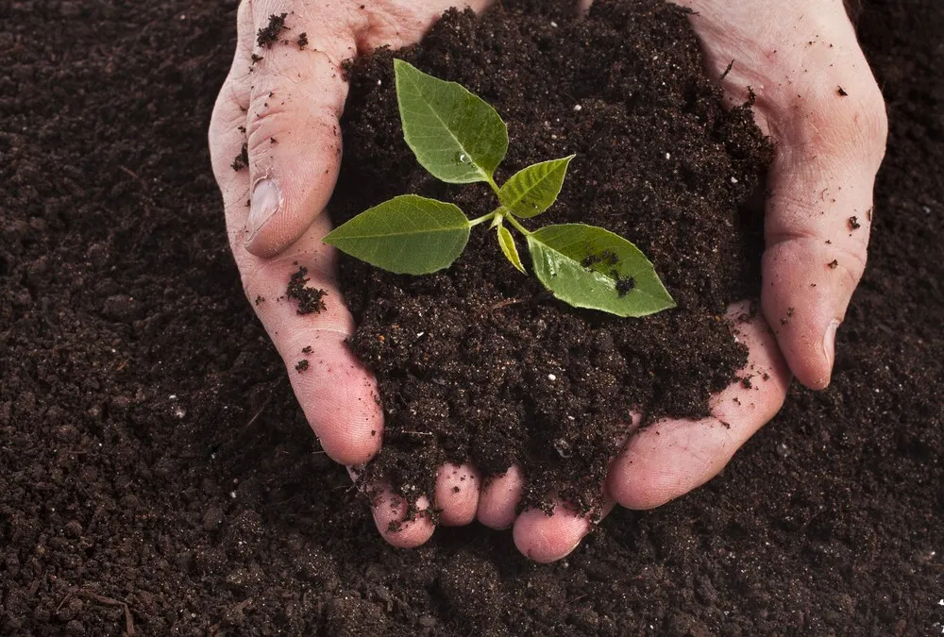
Soil Quality
Good quality soils are soils that have the ability to support a variety of productive organisms.
Properties of good soil:
Aeration
Neutral pH
Nutrients (including organic matter)
Water retention
Deep topsoil layer

